Slide 1

Predicting Airbnb Rental Prices in NYC
Humairah Malek
Link to Jupyter Notebook workings: here

Slide 2




Background
Airbnb hosts are able to set their own prices for rentals
The price of the rental is probably influenced by a couple of factors:
Location
No. bedrooms
Room type
Competition
How can a host determine the price of a new rental without manually searching through the competition?
How can Airbnb ensure customers they are getting a good deal?
This project aims to use rental features to predict the daily rate of a listing in New York City.
Original Kaggle project: https://www.kaggle.com/dgomonov/new-york-city-airbnb-open-data

Slide 3




Data Sources
The data was gathered from two primary sources:
Kaggle
InsideAirbnb.com
We also gathered location data (longitude/latitude) of some of the most popular landmarks in New York

Slide 4
Data
The majority of data was provided from Kaggle, while some feature engineering was done to create new features
Available features
Listings data
Neighbourhood group (Manhattan, Brooklyn etc.)
Latitude/Longitude
Room type (private, entire apt, shared home)
Min. nights
Number of reviews
Host listings count
Reviews data
Date of review
Review comments
Detailed listings data
Accommodates/no. beds
Review score rating
Listing name
Additional features created
Distance from popular locations:
Distance from Brooklyn Bridge
Distance from Central Park
Distance from LGA airport
Distance from JFK airport
Calculated using longitude/latitude
Reviews sentiment:
Average review sentiment per listing
Distance from Statue of Liberty
Link to Jupyter Notebook workings: here
Link to listings data & Kaggle project: https://www.kaggle.com/dgomonov/new-york-city-airbnb-open-data
Link to reviews & detailed listings data: http://insideairbnb.com/get-the-data.html

Slide 5
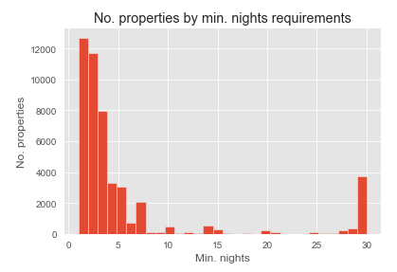
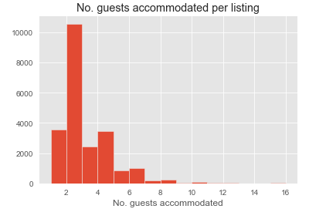
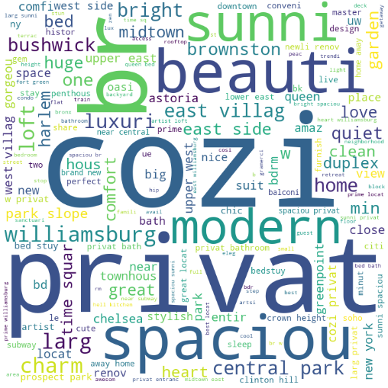
Property Insights
The majority of listings offer short-term stays (0-7 days)
The majority of listings accommodate 1-5 guests
Commonly used words in rental names are ‘cosy’, ‘private’ and ‘spacious’
Excludes min. nights > 30

Slide 6
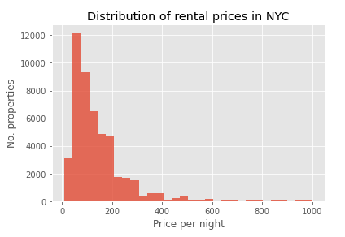
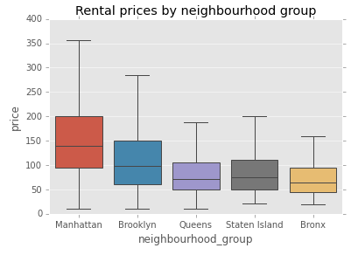
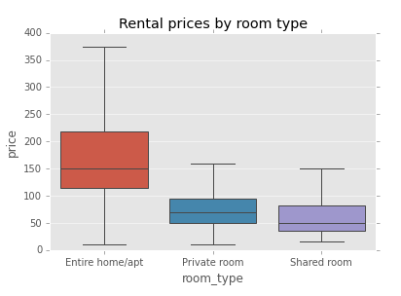
Pricing Insights
The majority of listings are priced between $75-300 per night
Average daily price: $152
There are also some extreme values beyond $1000 per night
Manhattan seems to be the most expensive area on average
Manhattan also has the widest range of listings in terms of price
Entire homes/apts are more expensive on average
The majority of listings are either Entire home/apts or Private rooms
Plots exclude extreme values

Slide 7
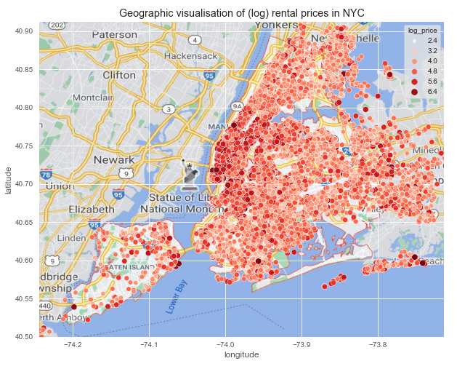
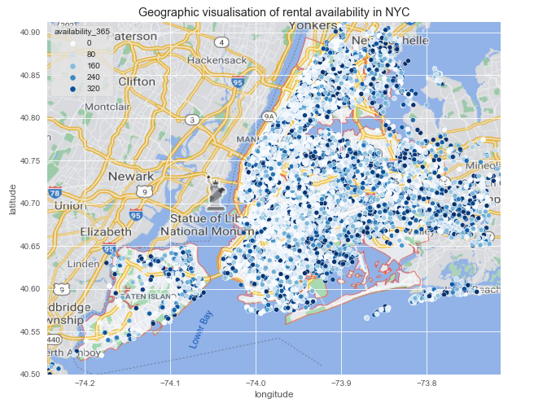
Geographical Insights
We can see clusters of the most expensive properties around the Manhattan area, although there are also some in surrounding neighbourhoods
We can also see less availability in Manhattan and Brooklyn
Possibly driven by popularity but could also be due to hosts renting part-time only
Dots represent log(price)
Dots represent availability in next 365 days

Slide 8



Hypotheses
Based on the insights found, we assumed the main drivers of price are:
Location
Room type
Accommodates
Distance from popular landmarks
Average review score

Slide 9



Features used
'minimum_nights’ – min stay requirement set by host (1-30 nights)
'number_of_reviews’ – no. reviews posted by customers
'reviews_per_month’ – average no. reviews posted per month
'calculated_host_listings_count’ – number of listings each host has
'neighbourhood_Brooklyn’ – 0/1 (1 if the neighbourhood is Brooklyn)
'neighbourhood_Manhattan’ – 0/1 (1 if the neighbourhood is Manhattan)
'neighbourhood_Queens’ – 0/1 (1 if the neighbourhood is Queens)
'neighbourhood_Staten Island’ – 0/1 (1 if the neighbourhood is Staten Island)
'room_Private room’ – 0/1 (1 if the room is a Private room)
'room_Shared room’ – 0/1 (1 if the room is a Shared room)
'sentiment’ – average sentiment from the reviews posted per property (-1 to 1)
'dist_central_park’ – Distance in km from Central Park
'dist_brooklyn_bridge’ – Distance in km from Brooklyn Bridge
'dist_LGA_airport' – Distance in km from LaGuardia Airport
'dist_JFK_airport’ – Distance in km from JFK Airport
'accommodates’ – No. people accommodated by listing
'review_scores_rating’ – 0-100 score of review scores
Link to Jupyter Notebook workings: here

Slide 10

Data Cleaning
Only took listings available in all three main datasets
Looked at listings priced <= $500 per night only
(very few priced > $500)
Removed handful of listings priced at $0 per night
(11 listings removed)
Removed listings with >30 nights min. stay requirement
Dist_statue_liberty & Dist_Brooklyn_Bridge were almost perfectly correlated (0.97!) and so we only used one of these as a feature
Replaced null reviews_per_month with 0’s
Resulted in ~18,700 rows to work with

Slide 11


Model Approach
Linear Regression
Decision Tree
Random Forest
Ridge Regression
RMSE: 62
RMSE: 54
RMSE: 53
RMSE: 49
70/30 Train/test split
Response Variable: Price
Evaluation Metric: RMSE
Baseline (null model) RMSE: 80

Slide 12
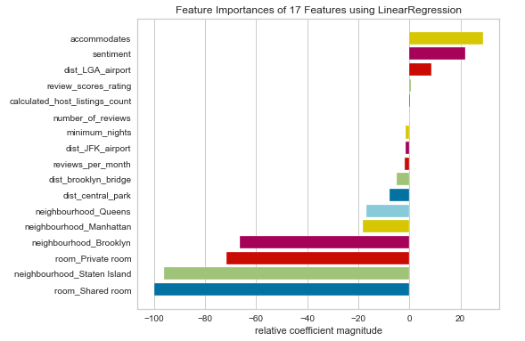
Model 1: Linear Regression
Assumes a linear relationship between the features and response variable
Model suggests the most important feature is ‘room_shared_room’
The least important features were review_scores_rating, number_of_reviews and calculated_host_listings_count
When forming predictions on the test set, model resulted in an RMSE of 61.8 (on average, the predicted values were off by ~$62 when run on test data)
The model was also overfit on the training data and didn’t perform as well on test data
We could have taken a log of price and used this for predictions, but the outcome and coefficients would have been less interpretable

Slide 13
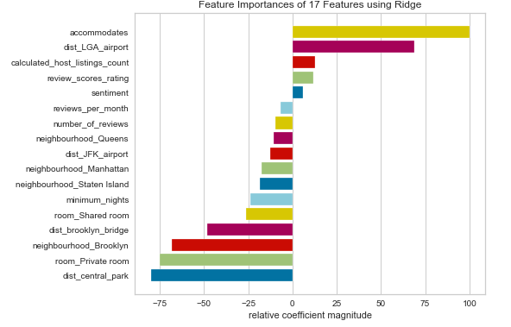
Model 2: Ridge Regression
Ridge Regression helps to reduce model variance, therefore minimises overfitting so that our model can predict well on unseen data
It does this by penalising coefficients (shrinking them towards 0) thereby reducing the effects of multicollinearity on the model
This model suggests ‘accommodates’ is the most important feature, followed by ‘dist_central_park’
When forming predictions on the test set, this model resulted in an RMSE of 54, which is better than the linear regression RMSE 62
However, ridge regression also assumes linearity between the features and response variable which may not be the case here
RidgeCV was used to find the optimal alpha (penalty coefficient) of 6.4
Similar RMSE when using LASSO
Features were scaled before building the model

Slide 14
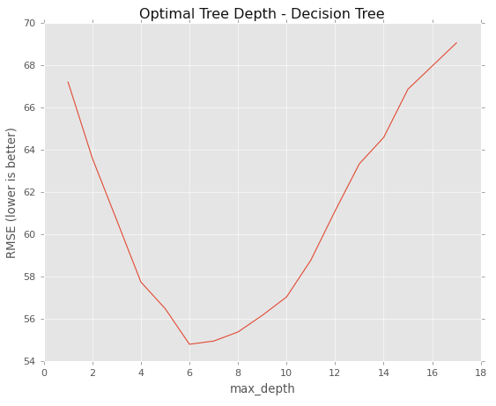
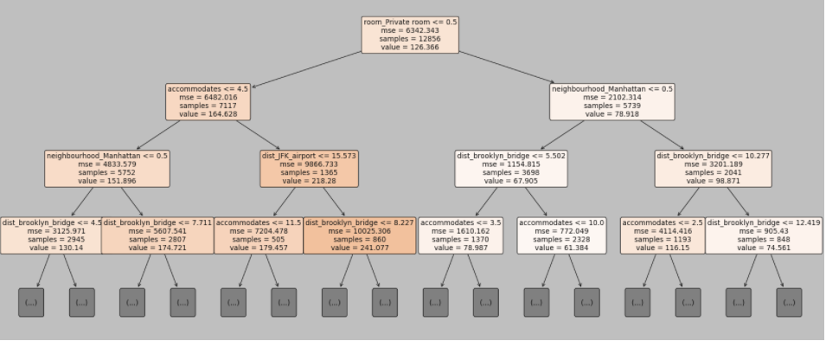
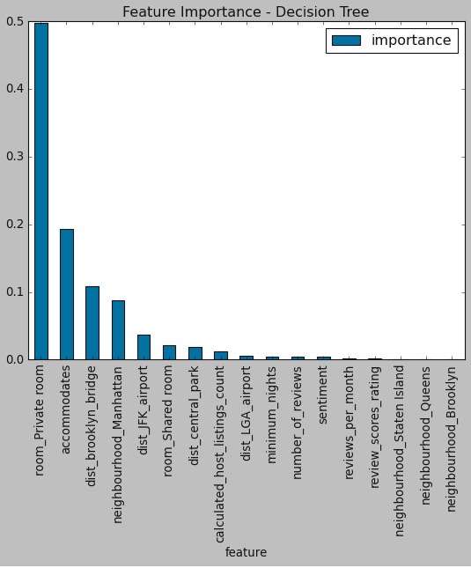
Model 3: Decision Tree Regressor
Decision trees are non-parametric, therefore will outperform linear models if the relationship between features and response is highly non-linear
This model suggests the most important feature is room_private_room, followed by accommodates
When forming predictions on the test set, this model resulted in an RMSE of 53 (slightly better than the Ridge Regression RMSE 54)
A disadvantage of this model is small variations in the data can result in a completely different tree (high variance)
Optimal tree depth of 6 levels was found using cross-validation
Full tree not displayed

Slide 15
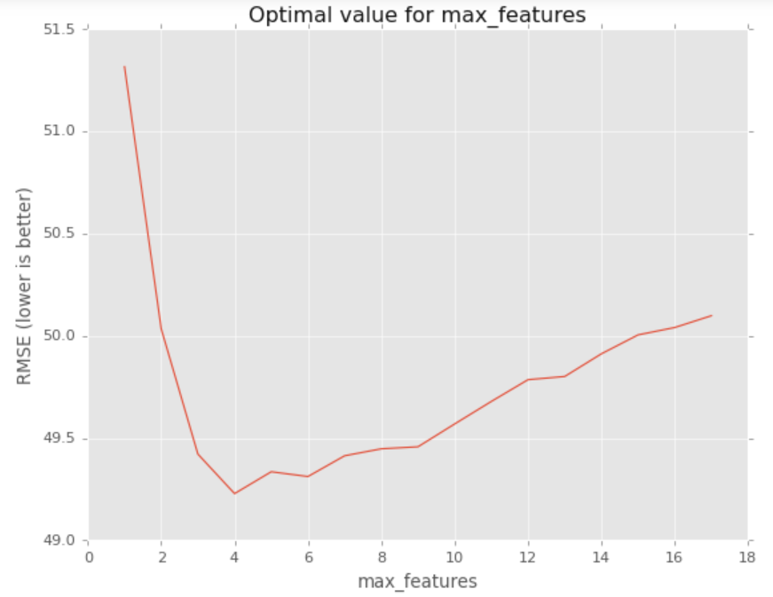
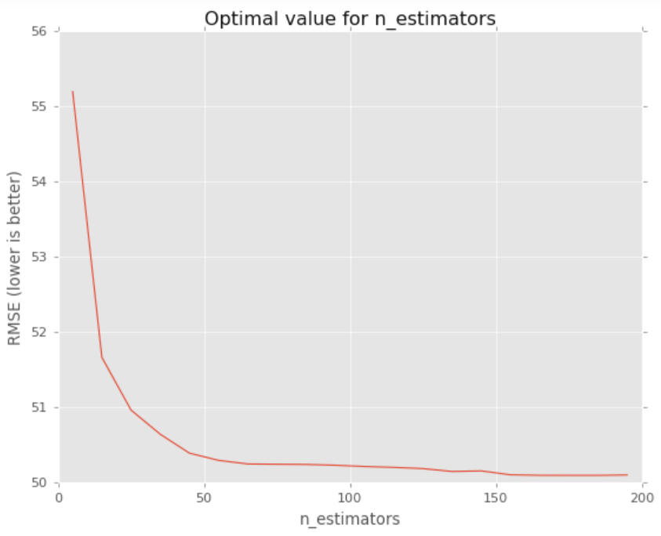
Best Model (so far): Random Forest Regressor
Random Forests are known to be better than most supervised learning methods and provide more reliable estimates of feature importance in comparison to decision trees
We built a Random Forest regressor with 185 trees and a max. of 4 features within each tree*
This model resulted in an RMSE of 49, which outperforms all previous models
The test RMSE was also similar to the train set RMSE, which shows we haven’t overfitted the model (performs well on unseen data)
*Optimal values for max_features and n_estimators were found using Cross Validation
Link to Jupyter Notebook workings: here

Slide 16
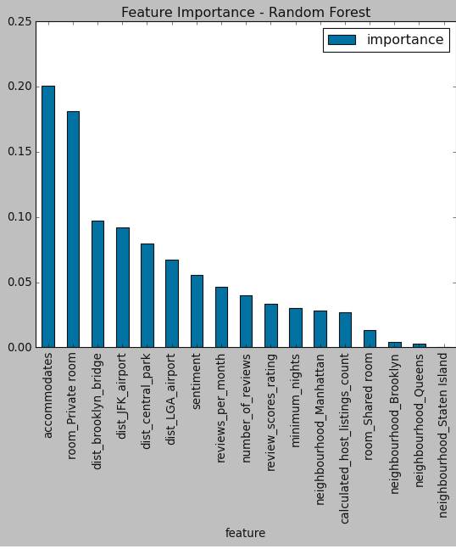
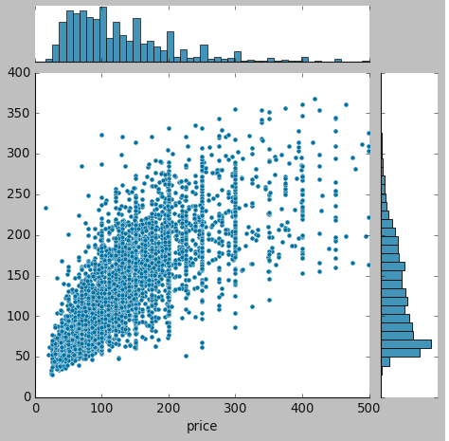
Understanding the Random Forest model
The biggest drivers of price are ‘accommodates’, ‘room_private_room’ & ‘dist_Brooklyn_Bridge’
The least important features in the model are the neighbourhood features, possibly as the distance features are more explanatory
The model doesn’t predict as well on listings priced above $250 per night
Due to lower volumes of data, it’s harder to predict the extreme values, but this model performed better in comparison to the others
Could also be hosts that are overcharging

Slide 17
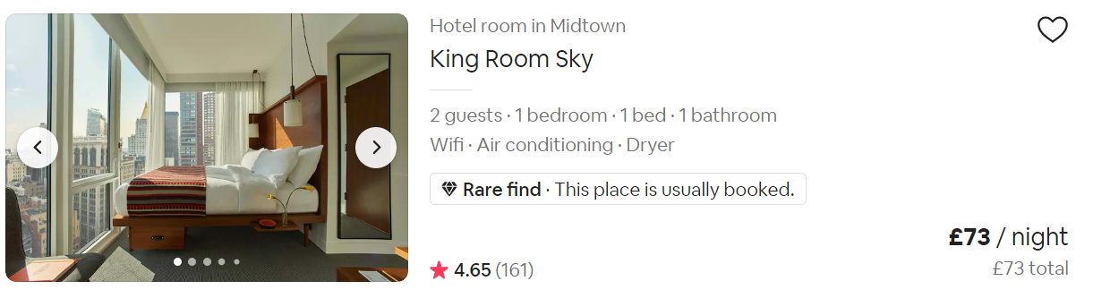

Use cases
By predicting the prices of rentals, Airbnb would be able to:
Give guidance to hosts on what their pricing should be
Identify rentals where hosts are charging excessive amounts (or undercharging significantly)
Guide customers by recommending rentals based on the price range of properties they have browsed previously
Create a ‘Value for money’ tag for properties that have been identified with great value based on similar properties and customer reviews
Great Value for money

Slide 18
Next Steps
Explore ways to improve the model further (e.g., adding peak/off-peak flag, amenities, transforming response variable)
Explore price prediction models for expensive listings that were not included
NLP on reviews data to understand customer sentiment around value and pricing, particularly for those that are much higher (or lower) than the predicted value

